Slide 1
Monday

Slide 2
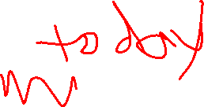
Course Logistics
Problem Set 3 – Due Wednesday, March 8
That’s pretty close to Exam 1 (March 6th). What are your thoughts? Currently looking at moving exam to March 13.
PS1, PS2 grading is ongoing…
Project Milestone 2.1 – Due Next Week!
All you’re doing is providing constructive feedback
Exam 1 – March 6 (?)
On Canvas, available all day, 50 minute time limit, course support during lecture slot…

Slide 3


Support Vector Machines
Notes:
https://media0.giphy.com/media/1MclE9Kaw3996/giphy.gif

Slide 4
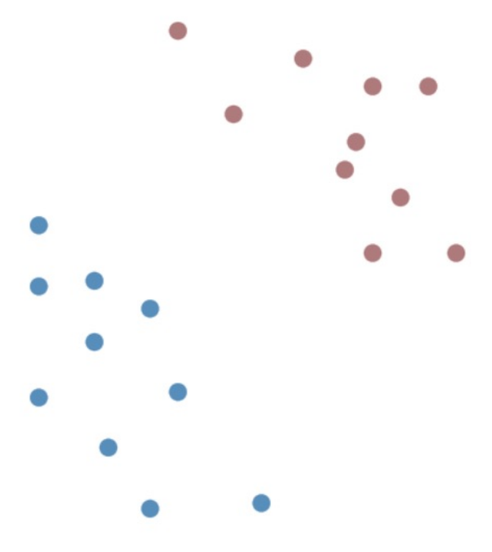
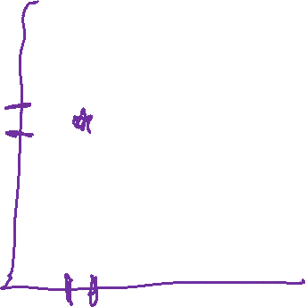
Classifying Points
Intuitively, how would we do this in…
KNN?
Naïve Bayes?
Logistic Regression?

Slide 5
Classifying Points
Naïve Bayes
Priors are equal
10 points vs. 10 points
Class-Conditional
Blue is more likely if x₁, x₂ are low, inverse
Evidence is a wash
The same across Red vs. Blue

Slide 6

Classifying Points
Logistic Regression
If the Logistic is < .5 it’s one, otherwise the other
Weights to x₁, x₂ to find decision point
Decision boundary is orthogonal to regression line

Slide 7
Linear Classifier
A linear classifier:
- calculates a weighted sum (w^{T}x)
- classifies based on w^{T}x >= threshold

Slide 8
Linear Classifier
A linear classifier:
- calculates a weighted sum (w^{T}x + b)
- classifies based on w^{T}x + b >= 0

Slide 9
Linear Classifier
A linear classifier:
- calculates a weighted sum (w^{T}x + b)
- classifies based on w^{T}x + b >= 0
New Representation
C = {-1, 1}

Slide 10
Classifying Points – 1D
w^{T}x + b >= 0 → w₁x₁ + b

Slide 11
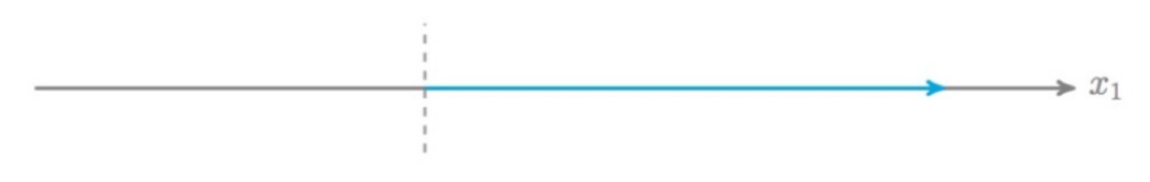
Classifying Points – 1D
w^{T}x + b >= 0 → w₁x₁ + b >= 0
x₁ >= -b / w₁

Slide 12
Classifying Points – 2D
w^{T}x + b >= 0 → w₁x₁ + w₂x₂ + b >= 0

Slide 13
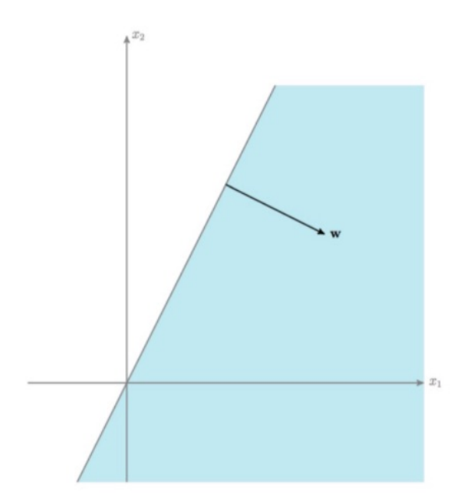
Classifying Points – 2D
w^{T}x + b >= 0 → w₁x₁ + w₂x₂ + b >= 0
X₂ >= -w₁x₁ - b
w₂

Slide 14
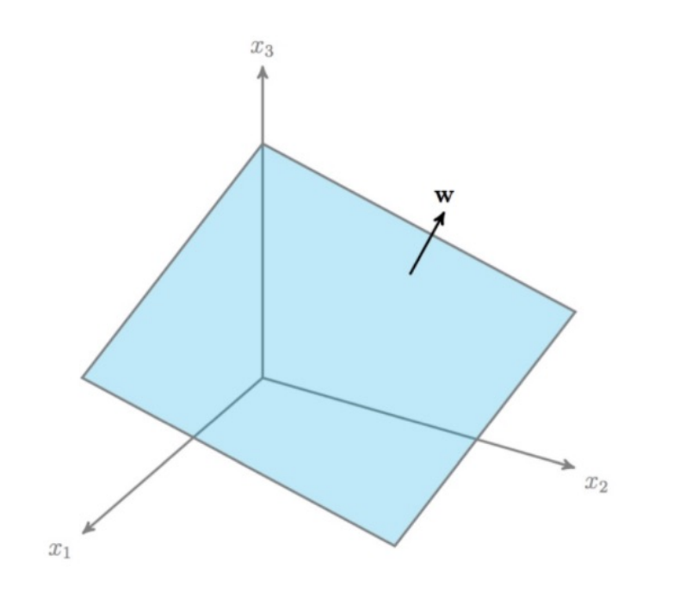
Classifying Points – 3D
Vector w is normal to the
decision boundary

Slide 15
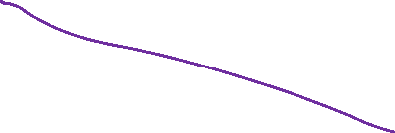
Decision Boundary
What is our best decision boundary?

Slide 16
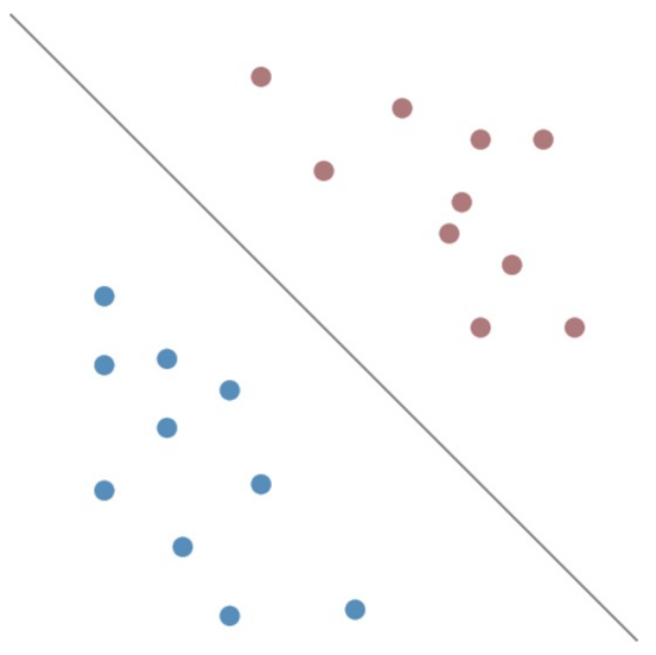

Best Decision Boundary
Why did we like this one the best?
Best gap boundary → examples
Biggest Margins

Slide 17
Best Decision Boundary
Why did we like this one the best?
Best gap boundary → examples
Biggest Margins
w^{T}x + b >> 0, very confident y_{i} = 1

Slide 18
Best Decision Boundary
Why did we like this one the best?
Best gap boundary → examples
Biggest Margins
w^{T}x + b << 0 , very confident y_{i} = -1

Slide 19
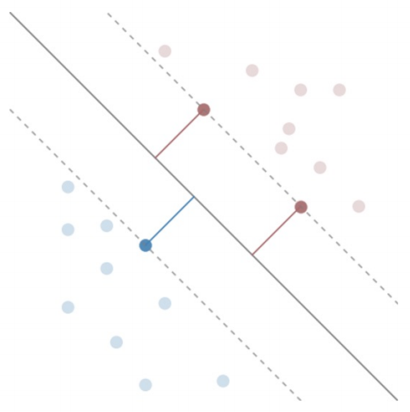
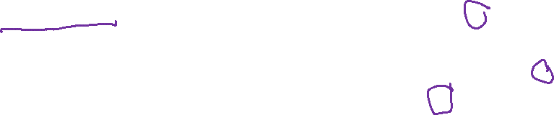
Best Decision Boundary
The Margin (M)
Distance DB → Closest Points
Support Vectors
closest Points to DB

Slide 20
Problem Space
X (examples x features)
What is our best decision boundary?
b + w₁x₁ + w₂x₂ + …
X₂
X₁

Slide 21
Best Decision Boundary
argmax_{w, b} (M) such that points are classified correctly

Slide 22

Best Decision Boundary
Support Vectors
w^{T}x + b = ± 1

Slide 23
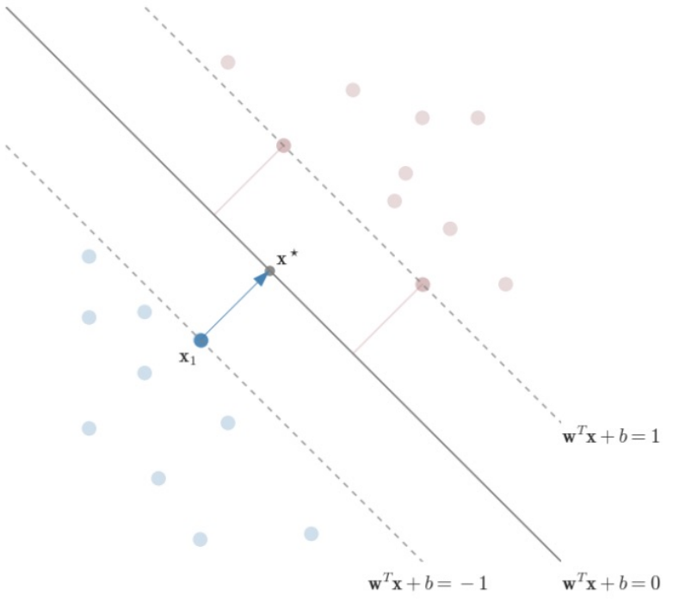
Maximizing our Margin

Slide 24
Maximizing our Margin
Choose support vector x₁
And closest point on DB x*
move from x₁ to x*
x* = x₁ + λw

Slide 25
Maximizing our Margin
Margin is distance moved
M = ||λw|| = λ||w||
x* is on the decision boundary
w^{T}x* + b = 0
x₁ is on the -1 boundary
w^{T}x₁ + b = -1

Slide 26
Maximizing our Margin
x* = x₁ + λw (1)
w^{T}x* + b = 0 (2)
w^{T}x₁ + b = -1 (3)

Slide 27
Maximizing our Margin
x* = x₁ + λw (1)
w^{T}x* + b = 0 (2)
w^{T}x₁ + b = -1 (3)
(1) Into (2)
w^{T} (x₁ + λw) + b = 0

Slide 28
Maximizing our Margin
x* = x₁ + λw (1)
w^{T}x* + b = 0 (2)
w^{T}x₁ + b = -1 (3)
(1) Into (2)
w^{T} (x₁ + λw) + b = 0 →
w^{T}x₁ + λ w^{T} w + b = 0 →
w^{T}x₁ + b + λ w^{T} w = 0 (4)

Slide 29
Maximizing our Margin
x* = x₁ + λw (1)
w^{T}x* + b = 0 (2)
w^{T}x₁ + b = -1 (3)
(1) Into (2)
w^{T} (x₁ + λw) + b = 0 →
w^{T}x₁ + λ w^{T} w + b = 0 →
w^{T}x₁ + b + λ w^{T} w = 0 (4)
(3) Into (4)
-1 + λ w^{T} w = 0 → λ w^{T} w = 1 (5)

Slide 30
Maximizing our Margin
Norm w (||w||) is the magnitude of w
||w|| = √(w₁²+ w₂²+ w₃²+…+ w_{n}²)
Dot Product of a vector with itself (transposed) is the norm squared
||w||² = (w₁²+ w₂²+ w₃²+…+ w_{n}²) = w^{T}w (6)

Slide 31
Maximizing our Margin
x* = x₁ + λw (1)
w^{T}x* + b = 0 (2)
w^{T}x₁ + b = -1 (3)
(1) Into (2)
w^{T} (x₁ + λw) + b = 0 →
w^{T}x₁ + λ w^{T} w + b = 0 →
w^{T}x₁ + b + λ w^{T} w = 0 (4)
(3) Into (4)
-1 + λ w^{T} w = 0 → λ w^{T} w = 1 (5)
||w||² = w^{T}w (6)
(6) Into (5)
λ ||w||² = 1

Slide 32
Maximizing our Margin
x* = x₁ + λw (1)
w^{T}x* + b = 0 (2)
w^{T}x₁ + b = -1 (3)
(1) Into (2)
w^{T} (x₁ + λw) + b = 0 →
w^{T}x₁ + λ w^{T} w + b = 0 →
w^{T}x₁ + b + λ w^{T} w = 0 (4)
(3) Into (4)
-1 + λ w^{T} w = 0 → λ w^{T} w = 1 (5)
||w||² = w^{T}w (6)
(6) Into (5)
λ ||w||² = 1 (7)
M = ||λw|| = λ||w|| (8)
(8) Into (7)
M = 1 / ||w||

Slide 33
Best Decision Boundary
argmax_{w, b} (M) such that points are classified correctly

Slide 34
Best Decision Boundary
argmax_{w, b} (M) such that points are classified correctly
argmax_{w, b} (1 / ||w||) such that points are classified correctly

Slide 35
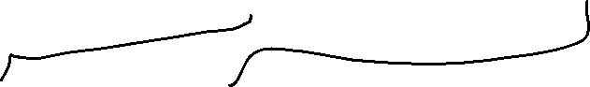
Best Decision Boundary
argmax_{w, b} (M) such that points are classified correctly
argmax_{w, b} (1 / ||w||) such that points are classified correctly
w^{T}x_{i} + b <= -1 if y_{i} = -1
w^{T}x_{i} + b >= 1 if y_{i} = 1

Slide 36
Best Decision Boundary
argmax_{w, b} (M) such that points are classified correctly
argmax_{w, b} (1 / ||w||) such that points are classified correctly
w^{T}x_{i} + b <= -1 if y_{i} = -1
w^{T}x_{i} + b >= 1 if y_{i} = 1
y_{i}(w^{T}x_{i} + b) >= 1 for i = {1,2,…,m}

Slide 37
Best Decision Boundary
argmax_{w, b} (1 / ||w||) such that y_{i}(w^{T}x_{i} + b) >= 1 for i = {1,2,…,m}
Optimize to find w, b

Slide 38
Best Decision Boundary
argmax_{w, b} (1 / ||w||) such that y_{i}(w^{T}x_{i} + b) >= 1 for i = {1,2,…,m}
Optimize to find w, b
But it’s not differentiable! (i.e. we can’t find a gradient vector)

Slide 39
Best Decision Boundary
argmax_{w, b} (1 / ||w||) such that y_{i}(w^{T}x_{i} + b) >= 1 for i = {1,2,…,m}
Not Differentiable
argmin_{w, b} (||w||) such that y_{i}(w^{T}x_{i} + b) >= 1 for i = {1,2,…,m}

Slide 40
Best Decision Boundary
argmax_{w, b} (1 / ||w||) such that y_{i}(w^{T}x_{i} + b) >= 1 for i = {1,2,…,m}
Not Differentiable
argmin_{w, b} (||w||) such that y_{i}(w^{T}x_{i} + b) >= 1 for i = {1,2,…,m}
Not Differentiable

Slide 41
Best Decision Boundary
Support Vectors
w^{T}x + b = ± 1
DB is unaffected by scale
(2w)^{T}x + 2b = 0

Slide 42
Best Decision Boundary
argmax_{w, b} (1 / ||w||) such that y_{i}(w^{T}x_{i} + b) >= 1 for i = {1,2,…,m}
Not Differentiable
argmin_{w, b} (||w||) such that y_{i}(w^{T}x_{i} + b) >= 1 for i = {1,2,…,m}
Not Differentiable
argmin_{w, b} (||w||²) such that y_{i}(w^{T}x_{i} + b) >= 1 for i = {1,2,…,m}
Convex + Differentiable
Requires a Convex quadratic program

Slide 43
Underlying Math – Finding our Maximum Margin

Slide 44
Generalizing – adding Lagrange Multipliers
min_{w} f(w) such that g_{i}(w) <= 0 for i = {1,2,…,m}

Slide 45
Generalizing – adding Lagrange Multipliers
min_{w} f(w)
such that g_{i}(w) <= 0 for i = {1,2,…,m}
The Lagrangian of this function
L(w, α) = f(w) + ∑_{i=1…m} (α_{i}g_{i}(w))
such that α_{i} >= 0

Slide 46
Generalizing – adding Lagrange Multipliers
min_{w} f(w)
such that g_{i}(w) <= 0 for i = {1,2,…,m}
The Lagrangian of this function
L(w, α) = f(w) + ∑_{i=1…m} (α_{i}g_{i}(w))
such that α_{i} >= 0
Max_{α} L(w, α) = f(w)*
* Holds if f(w) is feasible, otherwise it goes to infinity

Slide 47
Generalizing – adding Lagrange Multipliers
min_{w} max_{α} L(w, α) = min_{w} max_{α} f(w) + ∑_{i=1…m} (α_{i}g_{i}(w))
such that α_{i} >= 0
Problem is convex
Global minimum means
∇_{w} L(w, α) = 0 and ∇_{α} L(w, α) = 0

Slide 48
Generalizing – adding Lagrange Multipliers
min_{w} max_{α} L(w, α) = min_{w} max_{α} f(w) + ∑_{i=1…m} (α_{i}g_{i}(w))
such that α_{i} >= 0
Problem is convex
Global minimum means
∇_{w} L(w, α) = 0 and ∇_{α} L(w, α) = 0
min_{w} f(w)
such that g_{i}(w) <= 0 for i = {1,2,…,m}

Slide 49
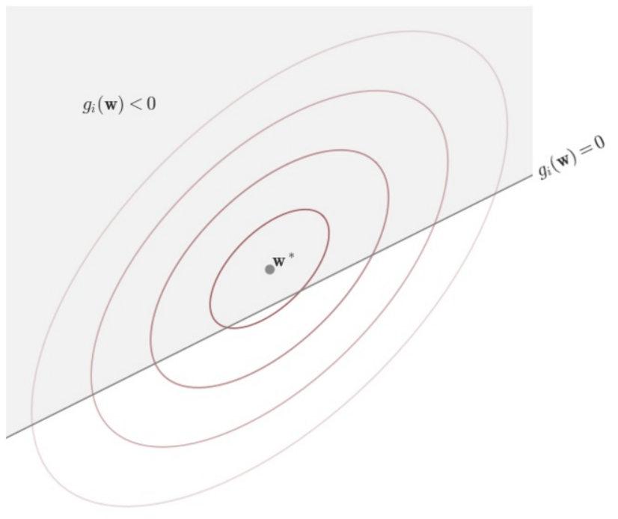
Visualizing f(x) and g(x)

Slide 50
Visualizing f(x) and g(x)
f(x) is minimized within the g_{i}(x) constraint, g_{i}(x) is inactive
we can “ignore” our α, α_{i} = 0
∇_{w} f(w) = 0

Slide 51
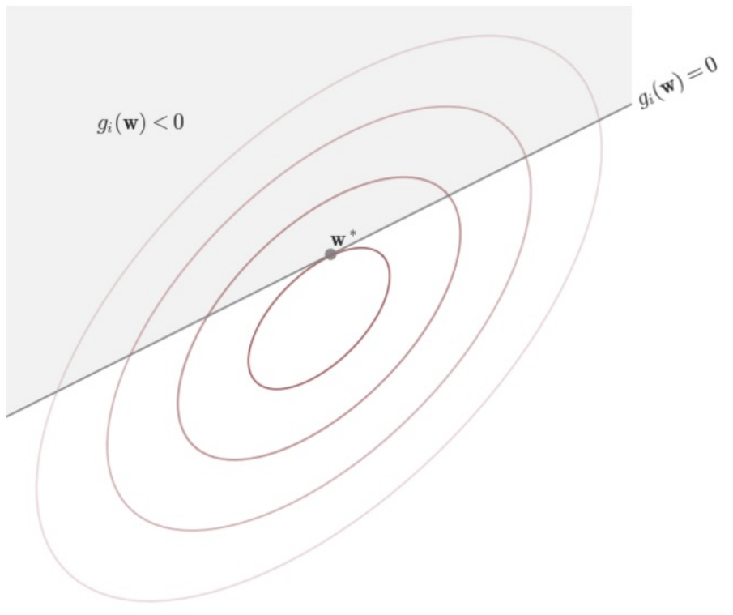
Visualizing f(x) and g(x)
f(x) is not minimized within the g_{i}(x) constraint, g_{i}(x) is active
α_{i} > 0

Slide 52
Complementary Slackness
α_{i}g_{i}(w*) = 0 for I = {1,2,…,m}
if α_{i} = 0 if we are not on the boundary of g_{i}
else α_{i} > 0

Slide 53
The Dual Formulation
min_{w} max_{α} L(w, α)
such that α_{i}g_{i}(w) = 0
and α_{i} >= 0
max_{α} min_{w} L(w, α) <= min_{w} max_{α} L(w, α)
DUAL PRIMAL

Slide 54
Our New Formulation
argmin_{w, b} (||w||²) such that y_{i}(w^{T}x_{i} + b) >= 1 for i = {1,2,…,m}
min_{w} max_{α} L(w, α) = min_{w} max_{α} f(w) + ∑_{i=1…m} (α_{i}g_{i}(w)) - PRIMAL
Becomes
L_{D} = max_{α} min_{w,b} (½||w||² + ∑_{i=1…m} (α_{i} (1 – y_{i}(w^{T}x_{i} + b))))
DUAL

Slide 55
Lagragian Form of Maximizing the Margin
L_{D} = max_{α} min_{w,b} (½||w||² + ∑_{i=1…m} (α_{i} (1 – y_{i}(w^{T}x_{i} + b))))
We want the derivative of w & b to be 0
Now that min_{w,b} is the inner optimization, we can do this!
w = ∑_{i} α_{i} y_{i} x_{i}
0 = ∑_{i} α_{i} y_{i}

Slide 56
Lagragian Form of Maximizing the Margin
L_{D} = max_{α} min_{w,b} (½||w||² + ∑_{i=1…m} (α_{i} (1 – y_{i}(w^{T}x_{i} + b))))
Apply complementary slackness & set derivative w, b to 0
Karush-Kuhn-Tucker Conditions
max_{α} (L_{D}) = max_{α} (∑_{i} α_{i} − ½ ∑_{i,j} α_{i} α_{j} y_{i} y_{j} x_{i} · x_{j})
α_{i} > 0 if y_{i}(w^{T}x_{i} + b) = 1
α_{i} = 0 if y_{i}(w^{T}x_{i} + b) < 1

Slide 57
Maximizing our Margin
max_{α} (∑_{i} α_{i} − ½ ∑_{i,j} α_{i} α_{j} y_{i} y_{j} x_{i} · x_{j})
α_{i} > 0 if y_{i}(w^{T}x_{i} + b) = 1
α_{i} = 0 if y_{i}(w^{T}x_{i} + b) > 1

Slide 58
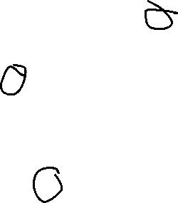
Maximizing our Margin
max_{α} (∑_{i} α_{i} − ½ ∑_{i,j} α_{i} α_{j} y_{i} y_{j} x_{i} · x_{j})
α_{i} > 0 if y_{i}(w^{T}x_{i} + b) = 1
α_{i} = 0 if y_{i}(w^{T}x_{i} + b) > 1
Most of these points (all the greyed out ones)
Are 0!
- They have no impact on what we are
maximizing…

Slide 59
A Less Good Margin
max_{α} (∑_{i} α_{i} − ½ ∑_{i,j} α_{i} α_{j} y_{i} y_{j} x_{i} · x_{j})
α_{i} > 0 if y_{i}(w^{T}x_{i} + b) = 1
α_{i} = 0 if y_{i}(w^{T}x_{i} + b) < 1

Slide 60
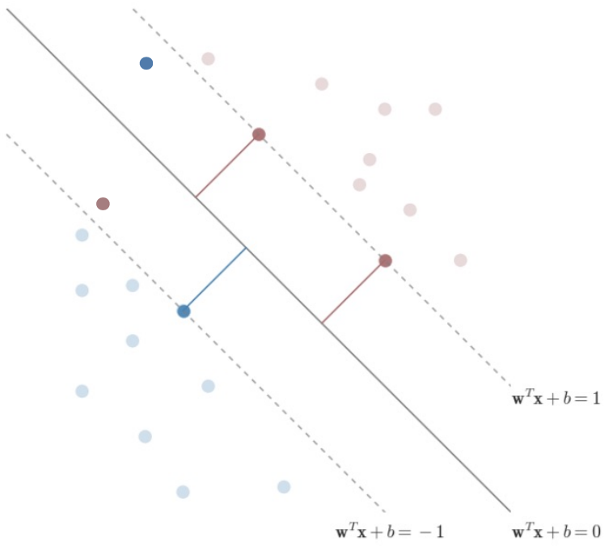
Shortcomings of Hard-Margin SVM
What if Linear Separability does not apply?

Slide 61
Interlude - Soft-Margin SVMs

Slide 62
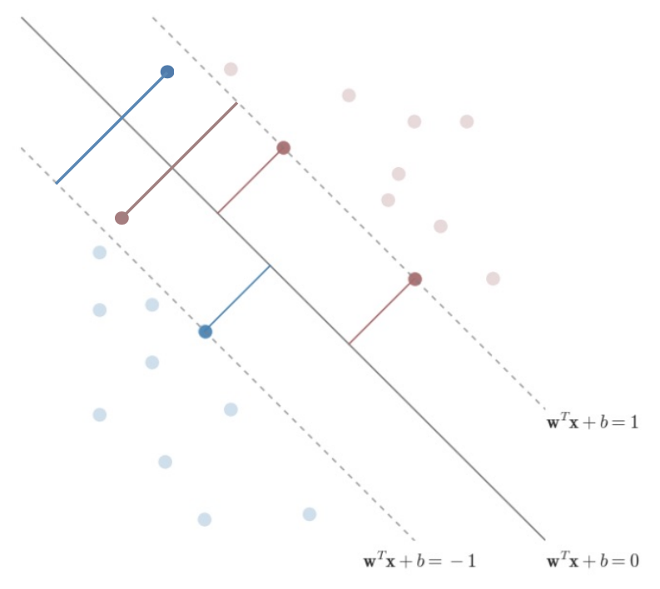
Overcoming Linear Separability Problem
Add some wiggle room to our
problem space

Slide 63
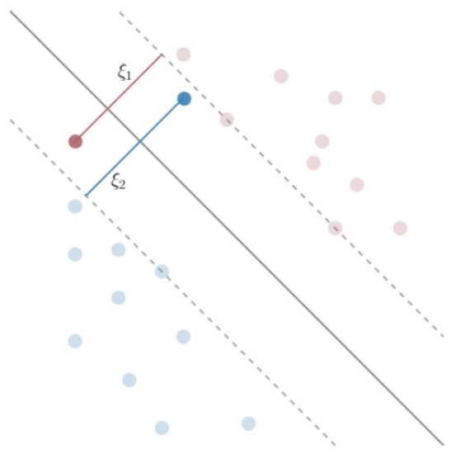
Adding a slack term ξ
Add a slack term ξ to every example
(for most examples the ξ is 0)

Slide 64
Adding a slack term ξ – Objective Function
argmin_{w, b} (½||w||²) → argmin_{w, b} (½||w||²) + C ∑_{i=1→m} ξ_{i}^{p}
C = Tuning Parameter
p = scaling of wrongness
p = 1 is often used

Slide 65
Adding a slack term ξ - Constraints
y_{i}(w^{T}x_{i} + b) >= 1 → y_{i}(w^{T}x_{i} + b) >= 1 – ξ_{i}
ξ_{i} relates to distance from the correct margin
ξ_{i} = 0 when we are on the correct side
(or on the boundary) of our margin
ξ_{i} = ½ when we are halfway between margin
and decision boundary
ξ_{i} = 2 when we are 1 margin on the wrong
side of the decision boundary

Slide 66
Adding a slack term ξ - Lagrangian
L(w,b,α) = (½||w||² + ∑_{i=1…m} (α_{i} (1 – y_{i}(w^{T}x_{i} + b)))) →
L(w,b,α,ξ)= (½||w||² - ∑_{i=1…m} (α_{i} (y_{i}(w^{T}x_{i} + b) – 1 + ξ_{i}))) - ∑_{i=1…m} β_{i}ξ_{i}
Add ξ as a term to minimize…

Slide 67
Adding a slack term ξ - Lagrangian
L(w,b,α) = (½||w||² + ∑_{i=1…m} (α_{i} (1 – y_{i}(w^{T}x_{i} + b)))) →
L(w,b,α,ξ)=(½||w||² - ∑_{i=1…m} (α_{i} (y_{i}(w^{T}x_{i} + b) – 1 + ξ_{i}))) - ∑_{i=1…m} β_{i}ξ_{i}
Add ξ as a term to minimize…
----------------------------------- Magic Happens -------------------------------------
max_{α} (∑_{i} α_{i} − ½ ∑_{i,j} α_{i} α_{j} y_{i} y_{j} x_{i} · x_{j}) – unchanged
New constraint: 0 <= α <= C

Slide 68
Adding a slack term ξ – Final Form
max_{α} (L_{D}) = max_{α} (∑_{i} α_{i} − ½ ∑_{i,j} α_{i} α_{j} y_{i} y_{j} x_{i} · x_{j})
α_{i} = C if y_{i}(w^{T}x_{i} + b) < 1
C > α_{i} > 0 if y_{i}(w^{T}x_{i} + b) = 1
α_{i} = 0 if y_{i}(w^{T}x_{i} + b) > 1

Slide 69
Maximizing our Margin
max_{α} (∑_{i} α_{i} − ½ ∑_{i,j} α_{i} α_{j} y_{i} y_{j} x_{i} · x_{j})
α_{i} > 0 if y_{i}(w^{T}x_{i} + b) = 1
α_{i} = 0 if y_{i}(w^{T}x_{i} + b) < 1

Slide 70
(Finally) Calculating our Maximum

Slide 71
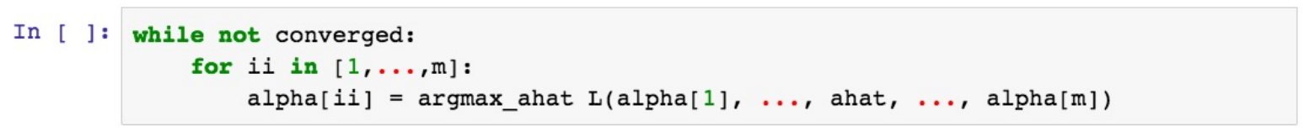
Coordinate Ascent
L(α_{i=1→m}) = (∑_{i} α_{i} − ½ ∑_{i,j} α_{i} α_{j} y_{i} y_{j} x_{i} · x_{j})
Change α_{i} to make L(α) as big as possible

Slide 72
Coordinate Ascent
L(α_{i=1→m}) = (∑_{i} α_{i} − ½ ∑_{i,j} α_{i} α_{j} y_{i} y_{j} x_{i} · x_{j})
Change α_{i} to make L(α) as big as possible
0 = ∑_{i=1→m} α_{i} y_{i}
We can’t change α_{i} one at a time!

Slide 73
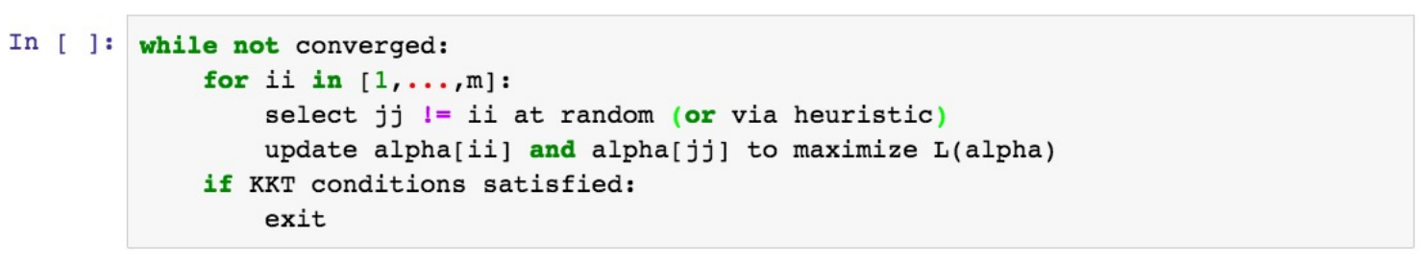
Sequential Minimal Optimizer
L(α_{i=1→m}) = (∑_{i} α_{i} − ½ ∑_{i,j} α_{i} α_{j} y_{i} y_{j} x_{i} · x_{j})
Change α_{i}, α_{j} to make L(α) as big as possible
0 = ∑_{i=1→m} α_{i} y_{i}

Slide 74
Sequential Minimal Optimizer
Change α_{i}, α_{j} to make L(α) as big as possible
0 = ∑_{i=1→m} α_{i} y_{i}
0 = α₁ y₁ + α₂ y₂ + ∑_{k=3→m} α_{k} y_{k}

Slide 75
Sequential Minimal Optimizer
Change α_{i}, α_{j} to make L(α) as big as possible
0 = ∑_{i=1→m} α_{i} y_{i}
0 = α₁ y₁ + α₂ y₂ + ∑_{k=3→m} α_{k} y_{k}
α_{i} y_{i} + α_{j} y_{j} = - ∑_{k!=i,j} α_{k} y_{k} = δ

Slide 76
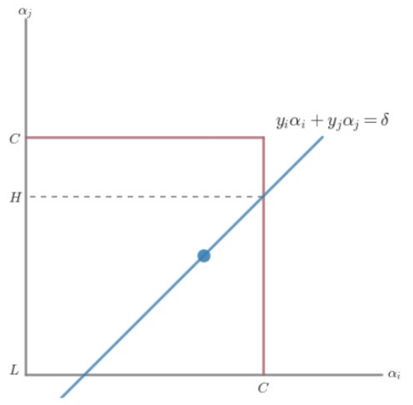
Sequential Minimal Optimizer
α_{i} y_{i} + α_{j} y_{j} = - ∑_{k!=i,j} α_{k} y_{k} = δ
0 <= α_{i} <= C

Slide 77
Sequential Minimal Optimizer
α_{i} y_{i} + α_{j} y_{j} = - ∑_{k!=i,j} α_{k} y_{k} = δ
0 <= α_{i} <= C
y_{i} != y_{j} y_{i} = y_{j}
L = max(0, α_{j} – α_{i}) or max(0, α_{j} + α_{i} – C)
H = min(C, C + α_{j} – α_{i}) or min(C, α_{j} + α_{i})

Slide 78
Sequential Minimal Optimizer
H if α_{j} > H
α_{j} = α_{j} if L <= α_{j} <= H
L if α_{j} < L
α_{i} such that α_{i} y_{i} + α_{j} y_{j} = - ∑_{k!=i,j} α_{k} y_{k} = δ

Slide 79
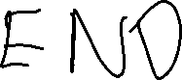
Sequential Minimal Optimizer
H if α_{j} > H
α_{j} = α_{j} if L <= α_{j} <= H
L if α_{j} < L
α_{i} such that α_{i} y_{i} + α_{j} y_{j} = - ∑_{k!=i,j} α_{k} y_{k} = δ

Slide 80
Wednesday

Slide 81
Course Logistics
Problem Set 3 – Due Wednesday, March 8
PS1, PS2 grading is ongoing…
Project Milestone 2.1 – Overdue!
Grades are released. If you didn’t get 25/25, come talk to me!
Exam 1 – March 13
On Canvas, available all day, 50 minute time limit, course support during lecture slot…

Slide 82
Exam 1 - Logistics
Delivered via Canvas
Open on March 13, Approximately all day
(Probably not 12:01AM to 11:59PM, but well beyond the class period, including morning through evening times)
It will be Timed to only allow you 50 minutes to complete
Those with 1.5X dispensation, etc. will be accommodated via Canvas.
Exam support will be provided in-lecture and via Zoom during lecture time.
A slightly longer window of support (i.e. to accommodate extra time students) will be via Zoom.

Slide 83
Exam 1 - Format
It is considered “open-resources”, but “individual”
Previous work, notes, Piazza discussions, textbook, etc. are all fair game
(Piazza will be in “read-only” mode for the day, so don’t be scared someone will post solutions there)
In general, follow the same plagiarism and honor code policies as any other assignment
Conceptual Questions
Closed-ended (multiple choice, matching, word bank, etc.)
Open-ended short answer with clear guidance (name one reason we would choose X over Y)
Problem Solving
Can be done with a calculator and some paper in a 50-minute exam
No coding or code analysis

Slide 84
Classification – Weeks 1 – 7*
K Nearest Neighbors
Manhattan, Euclidian Distance
Trees & Ensemble Methods
Splitting, Pruning
Random Forests
AdaBoost
Naïve Bayes
Class-Conditional, Prior, Evidence
Logistic Regression
Idea, Proof, Implementation
Gradient Descent
Stochastic & Mini-Batch Gradient Descent
SVM
Idea, Proof, Implementation
Sequential Minimal Optimizer
Kernel Trick

Slide 85
Regression
KNN
Trees & Ensembles
(We didn’t really deal with implementation here)
Linear Regression
Idea, Proof, Implementation
Minimizing MSE / LSS

Slide 86
Dimensionality Reduction
Select-K-Best / Best Subset
Stepwise selection
Stagewise Selection
(We didn’t really deal with implementation here)
Lasso & Ridge Regression
Idea, Proof, Implementation
Within Linear Regression

Slide 87
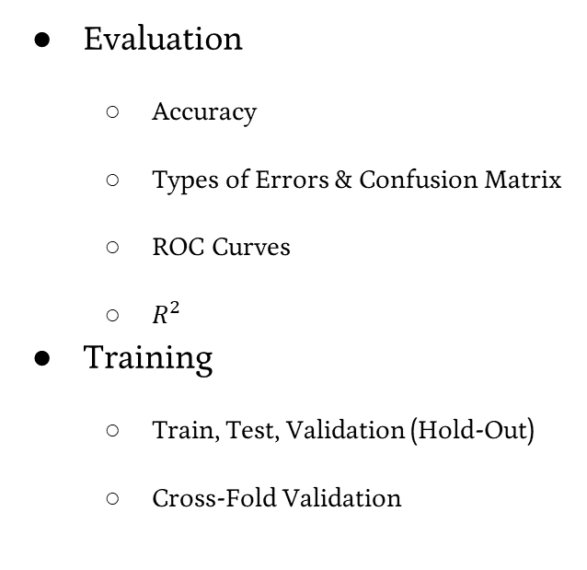
Skills
Evaluation
Accuracy
Types of Errors & Confusion Matrix
ROC Curves
$R^{2}$
Training
Train, Test, Validation (Hold-Out)
Cross-Fold Validation
Multi-Class
One vs. All
All-Pairs (One vs. Another)
Data Transformation
Encoding, Binning, Smoothing, Binarization / One-Hot Encoding, etc.
Scaling & Normalization
Min-Max, Mean & Std. Dev

Slide 88
Concerns
Impact of Errors
False Positive vs. False Negative
Overfitting
High Variance
Underfitting
High Bias
Curse of Dimensionality
When to use what classifiers?

Slide 89
Participation: Exam 1 Review Poll

Slide 90
Best Decision Boundary
Why did we like this one the best?
Best gap boundary → examples
Biggest Margins

Slide 91
Best Decision Boundary
argmax_{w, b} (1 / ||w||) such that y_{i}(w^{T}x_{i} + b) >= 1 for i = {1,2,…,m}
Not Differentiable
argmin_{w, b} (||w||) such that y_{i}(w^{T}x_{i} + b) >= 1 for i = {1,2,…,m}
Not Differentiable
argmin_{w, b} (||w||²) such that y_{i}(w^{T}x_{i} + b) >= 1 for i = {1,2,…,m}
Convex + Differentiable
Requires a Convex quadratic program

Slide 92
Maximizing our Margin
max_{α} (∑_{i} α_{i} − ½ ∑_{i,j} α_{i} α_{j} y_{i} y_{j} x_{i} · x_{j})
α_{i} > 0 if y_{i}(w^{T}x_{i} + b) = 1
α_{i} = 0 if y_{i}(w^{T}x_{i} + b) > 1
Most of these points (all the greyed out ones)
Are 0!
- They have no impact on what we are
maximizing…

Slide 93
Adding a slack term ξ - Lagrangian
L(w,b,α) = (½||w||² + ∑_{i=1…m} (α_{i} (1 – y_{i}(w^{T}x_{i} + b)))) →
L(w,b,α,ξ)=(½||w||² - ∑_{i=1…m} (α_{i} (y_{i}(w^{T}x_{i} + b) – 1 + ξ_{i}))) - ∑_{i=1…m} β_{i}ξ_{i}
Add ξ as a term to minimize…
----------------------------------- Magic Happens -------------------------------------
max_{α} (∑_{i} α_{i} − ½ ∑_{i,j} α_{i} α_{j} y_{i} y_{j} x_{i} · x_{j}) – unchanged
New constraint: 0 <= α <= C

Slide 94
Sequential Minimal Optimizer
H if α_{j} > H
α_{j} = α_{j} if L <= α_{j} <= H
L if α_{j} < L
α_{i} such that α_{i} y_{i} + α_{j} y_{j} = - ∑_{k!=i,j} α_{k} y_{k} = δ

Slide 95
Shortcomings of Soft-Margin SVM
We added some wiggle room

Slide 96
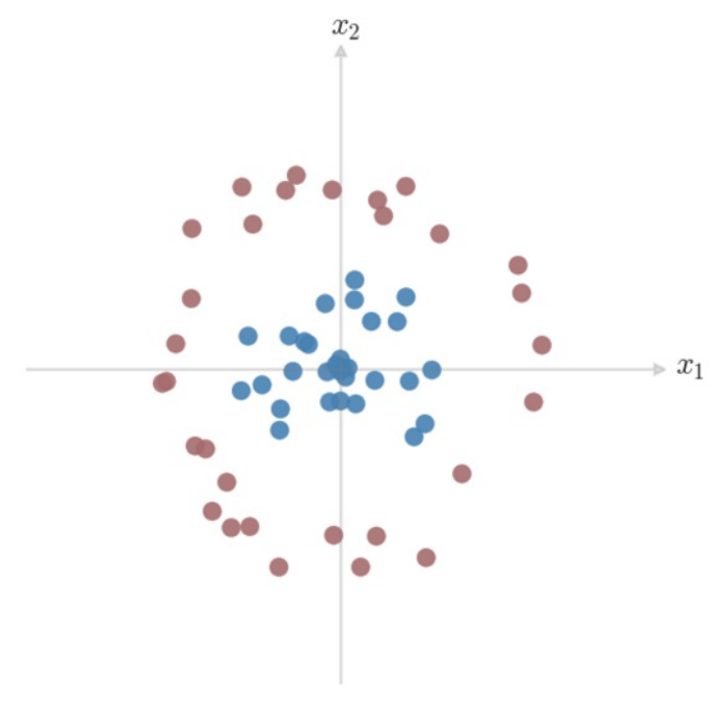

Shortcomings of Soft-Margin SVM
We added some wiggle room
But what if it’s not linearly separable?

Slide 97
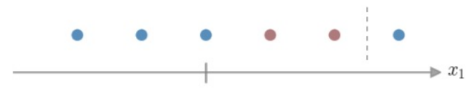
Linear Inseparability – 1D Case

Slide 98
Linear Inseparability – 1D Case
Your arterial blood’s pH should be between 7.35 and 7.45
Otherwise, you’re unhealthy (for some reason), we should run further tests.
https://www.maximumfun.org/sawbones/sawbones-alkaline-water
https://opentextbc.ca/anatomyandphysiology/chapter/26-5-disorders-of-acid-base-balance/

Slide 99
Linear Inseparability – 1D Case
What can we do to capture this idea?

Slide 100
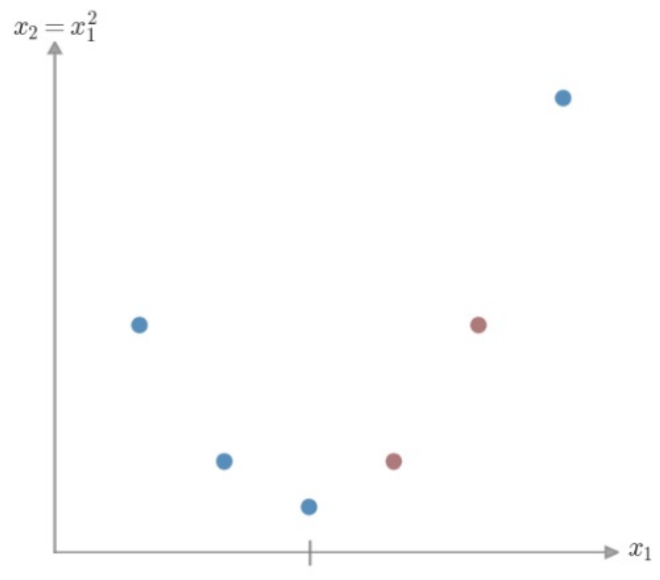
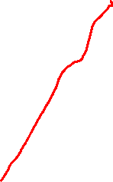
Linear Inseparability – 1D Case
Project our data into a higher dimensional space

Slide 101
Linear Inseparability – Dimension Projection
Start with our initial feature vector x = [x₁]
Create an augmented feature vector φ(x) = [x₁, x₁²]

Slide 102
Linear Inseparability – Dimension Projection
Start with our initial feature vector x = [x₁]
Create an augmented feature vector φ(x) = [x₁, x₁²]
Replace x with φ(x) in our optimization problem!

Slide 103
Our Optimization Problem
(∑_{i} α_{i} − ½ ∑_{i,j} α_{i} α_{j} y_{i} y_{j} x_{i} · x_{j})

Slide 104
Our Optimization Problem
(∑_{i} α_{i} − ½ ∑_{i,j} α_{i} α_{j} y_{i} y_{j} x_{i} · x_{j})
(∑_{i} α_{i} − ½ ∑_{i,j} α_{i} α_{j} y_{i} y_{j} φ(x)_{i} · φ(x)_{j})

Slide 105

Dimension Projection
How would we separate these classes?

Slide 106
Dimension Projection - Circle
How would we separate these classes?
We think in terms of sides of a boundary…

Slide 107
Dimension Projection
How would we separate these classes?
What kind of boundary can we give
this space?
Can we express that boundary in
terms of our given features?

Slide 108
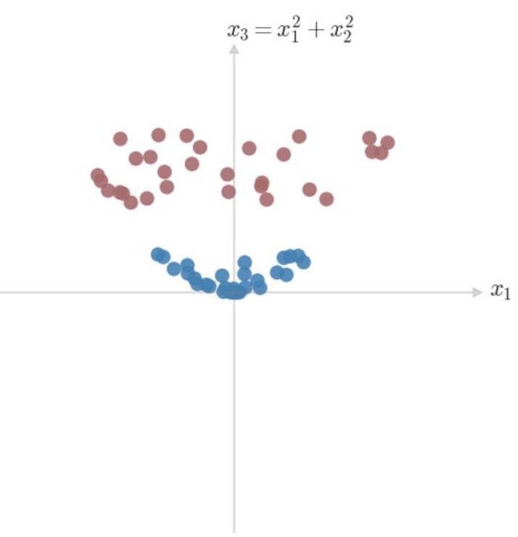
Dimension Projection
How would we separate these classes?
What kind of boundary can we give
this space?
Can we express that boundary in
terms of our given features?

Slide 109
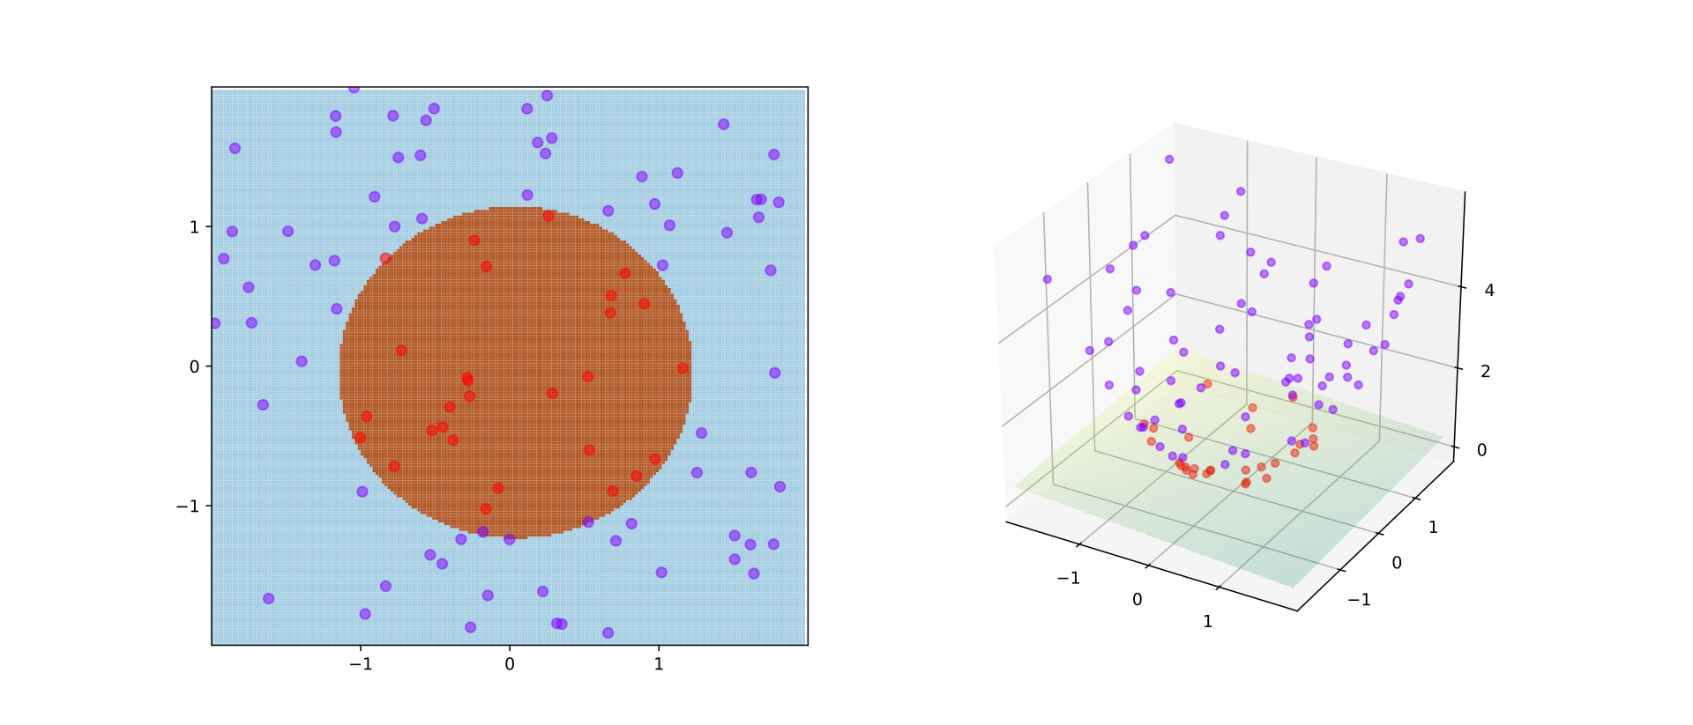
Dimension Projection - Circle
Notes:
https://en.wikipedia.org/wiki/Kernel_method#/media/File:Kernel_trick_idea.svg

Slide 110
Linear Inseparability – Dimension Projection
Start with our initial feature vector x = [x₁, x₂]
Create an augmented feature vector φ(x) = [x₁, x₂, x₁² + x₂²]
Replace x with φ(x) in our optimization problem!
Decision Boundary is a plane in 3D Space
x₁² + x₂² = constant

Slide 111
Our Optimization Problem
(∑_{i} α_{i} − ½ ∑_{i,j} α_{i} α_{j} y_{i} y_{j} x_{i} · x_{j})
(∑_{i} α_{i} − ½ ∑_{i,j} α_{i} α_{j} y_{i} y_{j} φ(x)_{i} · φ(x)_{j})

Slide 112
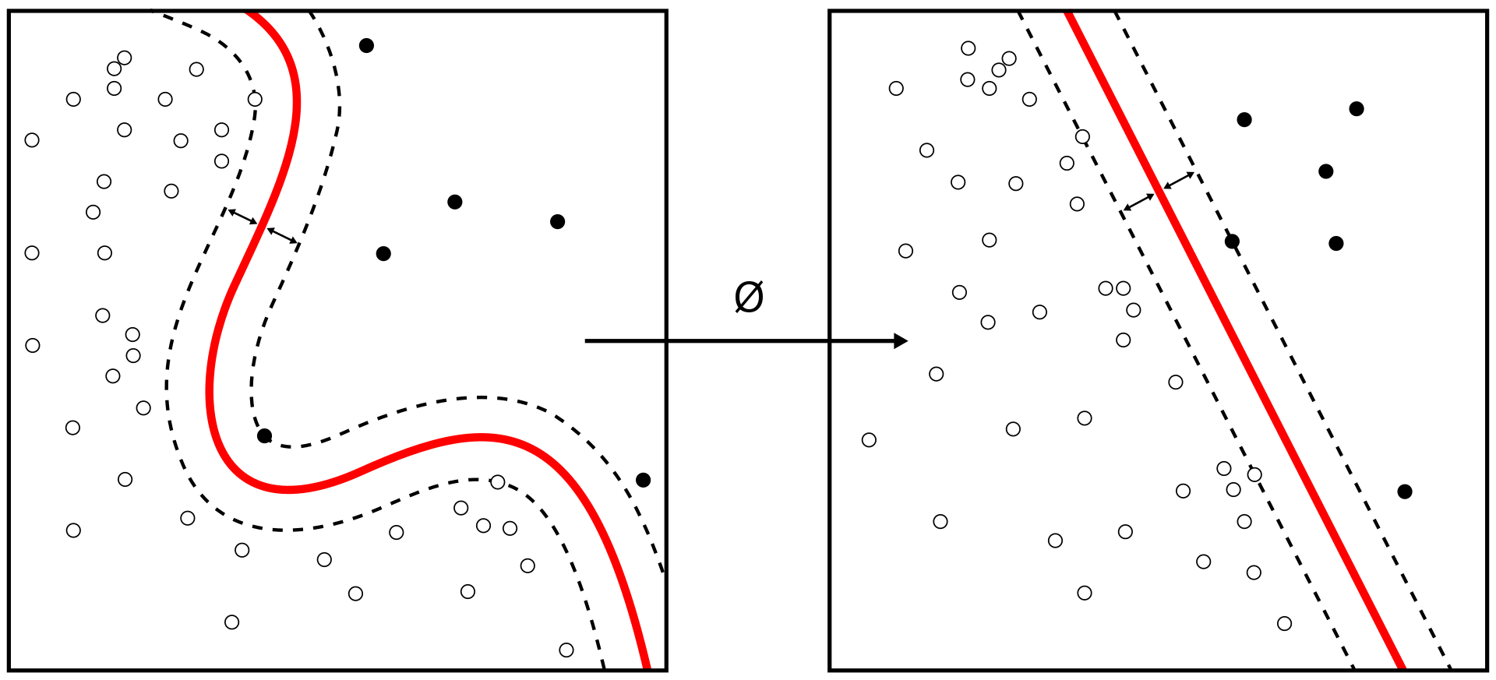
Generalizing our Optimization
Notes:
https://en.wikipedia.org/wiki/Kernel_method#/media/File:Kernel_Machine.svg

Slide 113
Our Optimization Problem – In Practice
For a 3-Dimensional Case…
X = [x₁,x₂,x₃]
φ(x) = (x_{i}^{T}x_{j})²

Slide 114
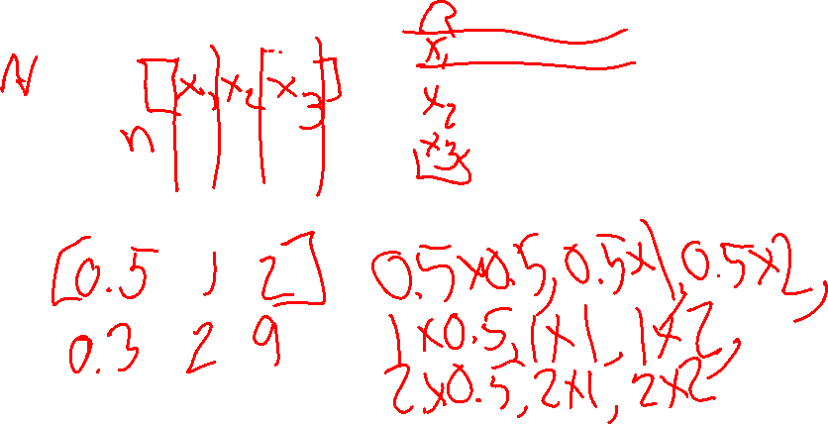
Our Optimization Problem – In Practice
For a 3-Dimensional Case…
X = [x₁,x₂,x₃]
φ(x) = (x_{i}^{T}x_{j})
φ[X] = [x₁ x₁, x₁ x₂, x₁ x₃, x₂ x₁, x₂ x₂, x₂ x₃, x₃ x₁, x₃ x₂, x₃ x₃]

Slide 115
Generalizing our Optimization – Curse of Dimensionality
Take a 64-feature vector
Transform it using φ(x) = (x_{i}^{T}x_{j})
How many dimensions do I have?

Slide 116
Generalizing our Optimization – Curse of Dimensionality
Take a 64-feature vector
Transform it using φ(x) = (x_{i}^{T}x_{j})
How many dimension do I have?
64^2 = 4096

Slide 117
Our Optimization Problem
(∑_{i} α_{i} − ½ ∑_{i,j} α_{i} α_{j} y_{i} y_{j} x_{i} · x_{j})
(∑_{i} α_{i} − ½ ∑_{i,j} α_{i} α_{j} y_{i} y_{j} φ(x)_{i} · φ(x)_{j})
Redefine φ(x)_{i} · φ(x)_{j} as K(x, z) (x_{i} becomes x, x_{j} becomes z)*
*there are restrictions on this mapping – we’ll get there!

Slide 118
Our Optimization Problem – In Practice
x, z are vectors of real numbers in N-Dimensional Space
K(x, z) = (x^{T}z)

Slide 119
Our Optimization Problem – In Practice
x, z are vectors of real numbers in N-Dimensional Space
K(x, z) = (x^{T}z)
K(x, z) = (∑_{i=1→n} (x_{i}z_{i})) (∑_{j=1→n} (x_{j}z_{j}))

Slide 120
Our Optimization Problem – In Practice
x, z are vectors of real numbers in N-Dimensional Space
K(x, z) = (x^{T}z)
K(x, z) = (∑_{i=1→n} (x_{i}z_{i})) (∑_{j=1→n} (x_{j}z_{j}))
= ∑_{i=1→n} ∑_{j=1→n}(x_{i}z_{i}x_{j}z_{j})
= ∑_{i,j=1→n}(x_{i}z_{i}x_{j}z_{j})
(∑_{i} α_{i} − ½ ∑_{i,j} α_{i} α_{j} y_{i} y_{j} (x_{i}z_{i}x_{j}z_{j}))

Slide 121
Kernels Save Time!
Computing φ(x) = (x_{i}^{T}x_{j}) takes O(n²)
Computing K(x,z) takes O(n)

Slide 122
Boundaries of Valid Kernels
For any set of points (x_{m}), you can store K(x_{i},x_{j}) in an m by m matrix K

Slide 123
Boundaries of Valid Kernels - Symmetry
For any set of points (x_{m}), you can store K(x_{i},x_{j}) in an m by m matrix K
K_{ij} = K(x^{i}) , x^{j} ) = φ(x^{i}))^{T} φ(x^{j}) = φ(x^{j})^{T} φ(x^{i}) = K(x^{j} , x^{i}) = K_{ji}
K must be symmetric

Slide 124
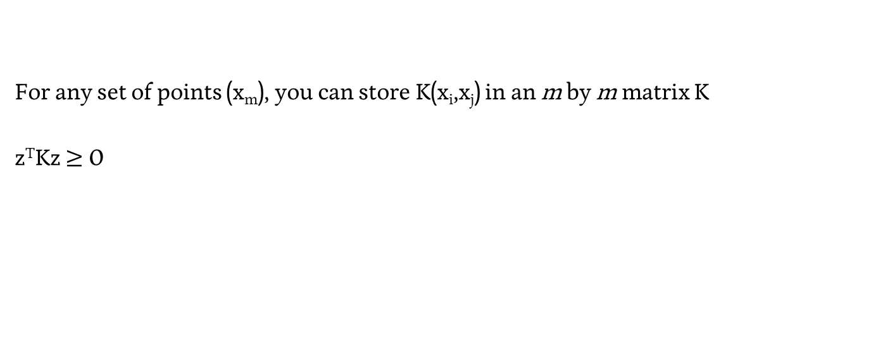
Boundaries of Valid Kernels – Positive Semi-Definite
For any set of points (x_{m}), you can store K(x_{i},x_{j}) in an m by m matrix K
z^{T}Kz $≥$ 0

Slide 125
Boundaries of Valid Kernels – Mercer’s Theorem
Theorem (Mercer). Let K : R^{n} × R^{n} → ℝ be given. Then for K to be a valid (Mercer) kernel, it is necessary and sufficient that for any {x¹, . . . , x^{m}}, (m < ∞), the corresponding kernel matrix is symmetric positive semi-definite.

Slide 126

Kernels Intuition
Dot product x · y tells you about the similarity between x and y
If both vectors are positive along a dimension, dot product will grow
If one vector is 0 along a dimension, dot product does not grow
If vectors are opposite signs along a dimension, dot product will shrink
Kernels just add dimension combinations to dot product!

Slide 127
Popular Kernels
Linear Kernel: K(x, z) = (x^{T}z)

Slide 128
Popular Kernels
Linear Kernel: K(x, z) = (x^{T}z)
Polynomial Kernel: K(x, z) = (x^{T}z + c)^{p}

Slide 129
Popular Kernels
Linear Kernel: K(x, z) = (x^{T}z)
Polynomial Kernel: K(x, z) = (x^{T}z + c)^{p}
Radial Basis Function(RBF) Kernel: K(x, z) = exp(- γ||x − z||²)

Slide 130
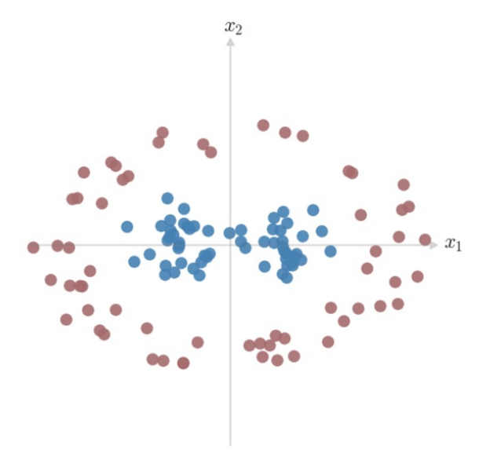
RBF Kernel for SVM

Slide 131
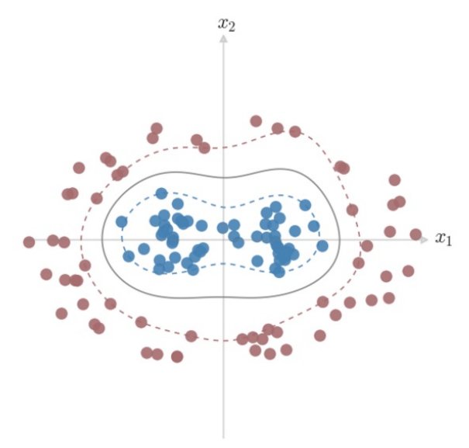

RBF Kernel for SVM
γ = 3
C = 5

Slide 132
Popular Kernels
Linear Kernel: K(x, z) = (x^{T}z)
Polynomial Kernel: K(x, z) = (x^{T}z + c)^{p}
Radial Basis Function(RBF) Kernel: K(x, z) = exp(- γ||x − z||²)
Gaussian RBF Kernel: K(x, z) = exp((- ||x − z||² ) / 2σ² )

Slide 133
SVM + Kernels
Pros
Works great “out-of-the-box”
Maintains convex objective function – guaranteed optimal solution
Solutions are sparse thanks to Kernels
Flexibly map to arbitrary decision boundary

Slide 134
SVM + Kernels
Pros
Works great “out-of-the-box”
Maintains convex objective function – guaranteed optimal solution
Solutions are sparse thanks to Kernels
Flexibly map to arbitrary decision boundary
Cons
Optimization can be slow
Choosing a Kernel is manual

Slide 135
Perceptrons
An Alternate Perspective

Slide 136
Linear Classification Task
w^{T}x + b → ± 1
If w^{T}x + b > 0, y = 1
If w^{T}x + b < 0, y = -1
w^{T}x + b = 0 is an edge case

Slide 137
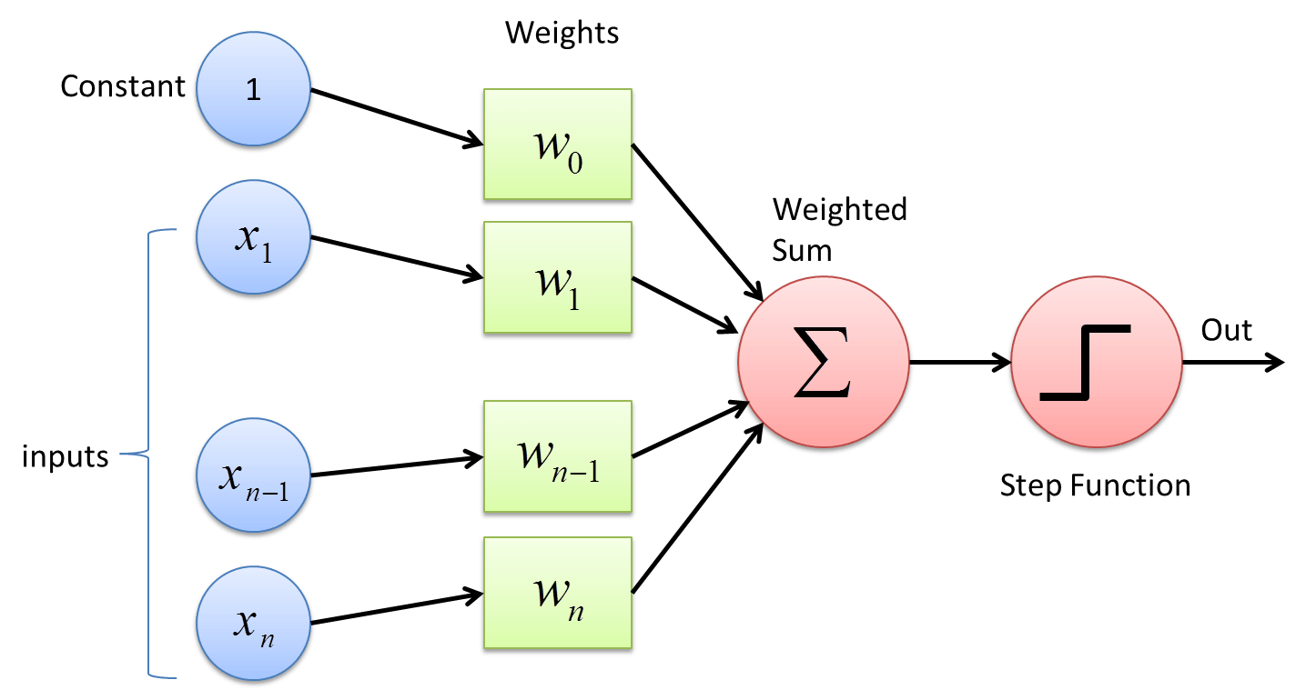
Visualizing Classification – The Perceptron
w^{T}x + b → ± 1
If w^{T}x + b > 0, y = 1
If w^{T}x + b < 0, y = -1
Notes:
https://cdn-images-1.medium.com/max/1600/1*n6sJ4yZQzwKL9wnF5wnVNg.png

Slide 138
Training a Perceptron – “Online” Learning
Initialize w to an all-zero vector.
For some fixed number of iterations, or until some stopping criterion is met:
For each training example xᵢ with ground truth label yᵢ ∈ {-1, 1}:
Let ŷ = sign(w^{T} xᵢ).
If ŷ ≠ yᵢ, update w ← w + yᵢ xᵢ.

Slide 139
Kernel Perceptron
Perform our Kernel transformation of our data, then generate our perceptron!

Slide 140
Kernel Perceptron
Create the matrix of our Kernel representation of our data
Linear Kernel: K(x, z) = (x^{T}z)
Polynomial Kernel: K(x, z) = (x^{T}z + c)^{p}
Radial Basis Function(RBF) Kernel: K(x, z) = exp(- γ||x − z||²)
Gaussian RBF Kernel: K(x, z) = exp((- ||x − z||² ) / 2σ² )

Slide 141
Training our Kernelized Perceptron (Fit)
We no longer have “weights” to train on…

Slide 142
Training our Kernelized Perceptron (Fit)
We no longer have “weights” to train on…
But we can use our Dual Expression of the problem!
∑_{i=1→n} α_{i}y_{i}K(x_{i},x_{j})
And use the same perceptron update as before, but increment our α by 1 each time.
If an example incremented α, then it’s a support vector

Slide 143
Friday

Slide 144
Course Logistics
Problem Set 3 – Due Wednesday, March 8
PS1 grading complete!
PS2 grading is ongoing…
Project Milestone 2.1 – Overdue!
Grades are released. If you didn’t get 25/25, come talk to me!
Exam 1 – March 13
On Canvas, available all day, 50 minute time limit, course support during lecture slot…

Slide 145


OH Cancelled Today
Do you want tonight (8 – 9 PM) or Sat. (2 – 3PM) OH?

Slide 146

Interlude: Pros and Cons
When to use what classifiers

Slide 147


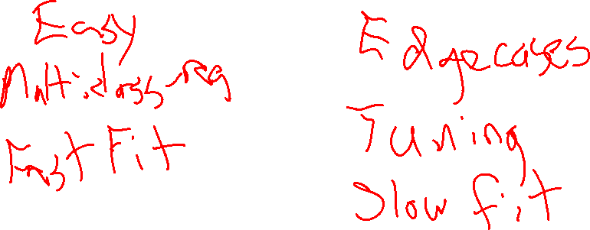
K-Nearest Neighbors
Pro
Con

Slide 148
K-Nearest Neighbors
Pro
Con (Ex)
Works with small N
Works for non-binary cases
Can be run without training
Doesn’t give much of a description of results beyond “similar to A, B, C…”
Has trouble with features at differing scales
Predict is slow

Slide 149
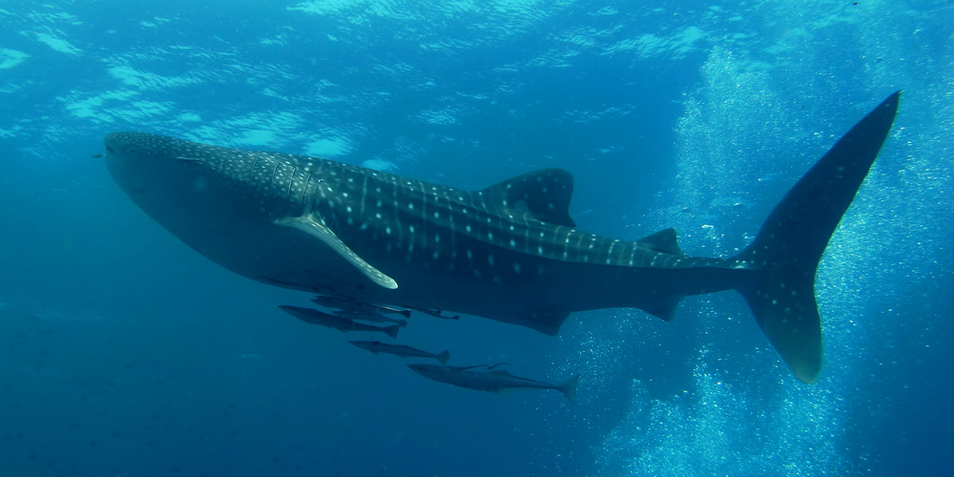
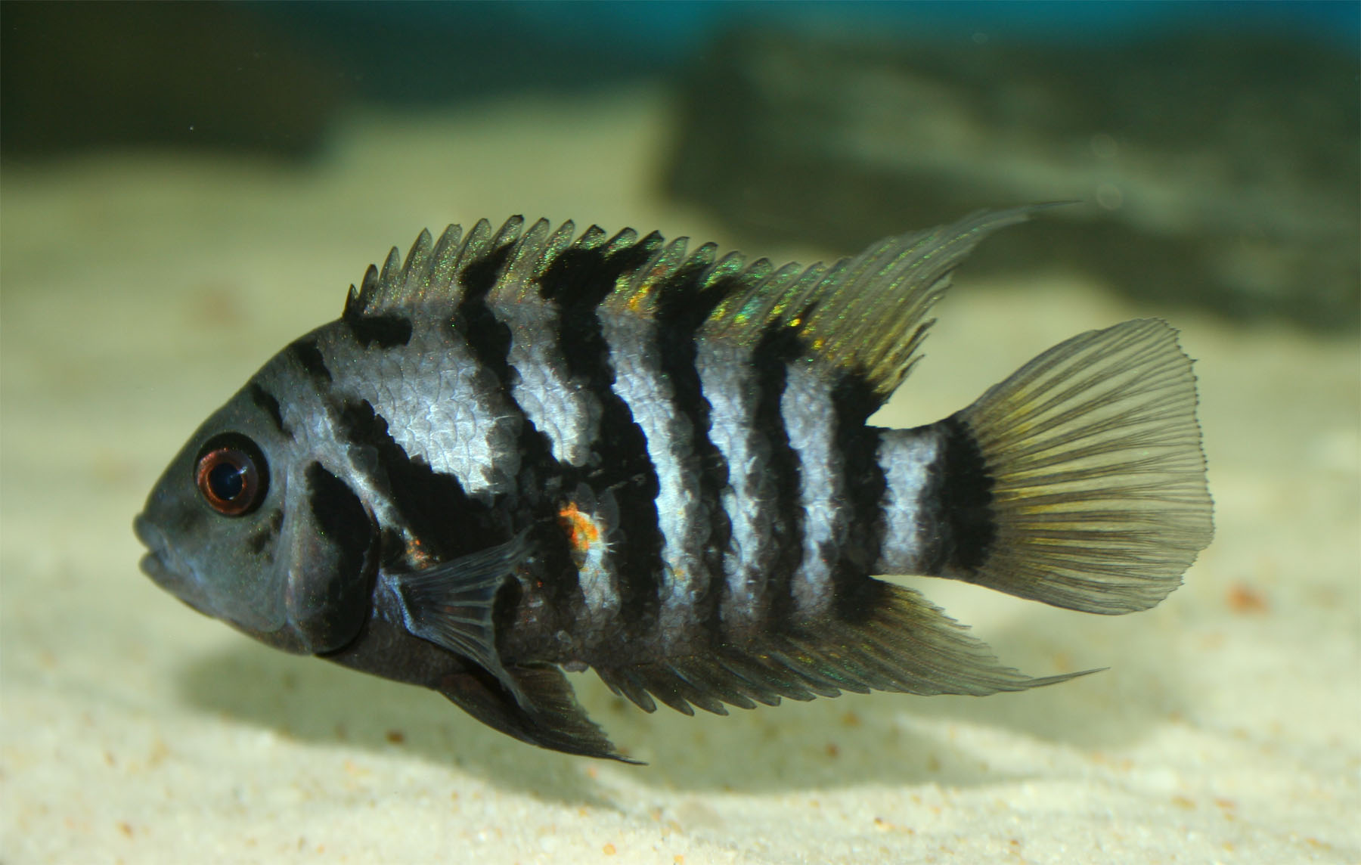
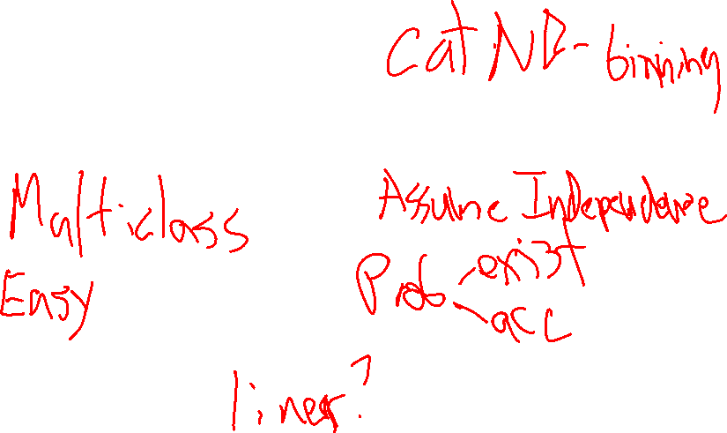
Naïve Bayes
Pro
Con

Slide 150
Naïve Bayes
Pro
Con
Works for non-binary cases
Quick Training
Gives relative probabilities for each class
Hard to implement for non-categorical data (without binning)

Slide 151

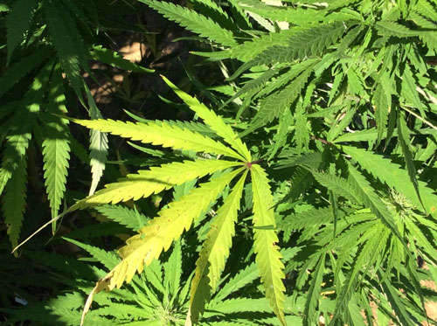
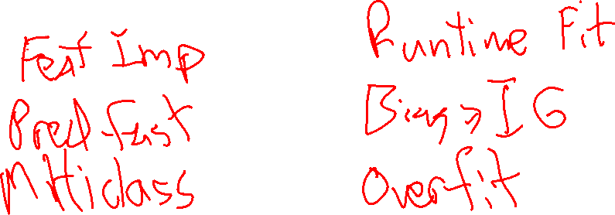
Decision Tree
Pro
Con (Ex)

Slide 152
Decision Tree
Pro
Con (Ex)
Easy to implement
Easy to follow
Easy(ish) to interpret
Prone to overfitting

Slide 153


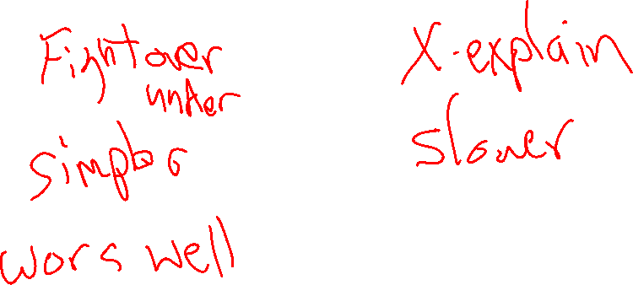
Ensembles: Random Forest / Adaboost
Pro
Con

Slide 154
Ensembles: Random Forest / Adaboost
Pro
Con (Ex)
Adaptive to difficult-to-classify cases
Difficult to interpret

Slide 155


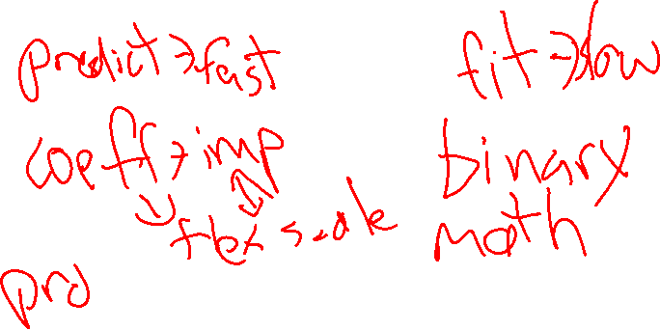
Logistic Regression
Pro
Con

Slide 156
Logistic Regression
Pro
Con
Linear decision boundary
Probabilistic
Binary only

Slide 157


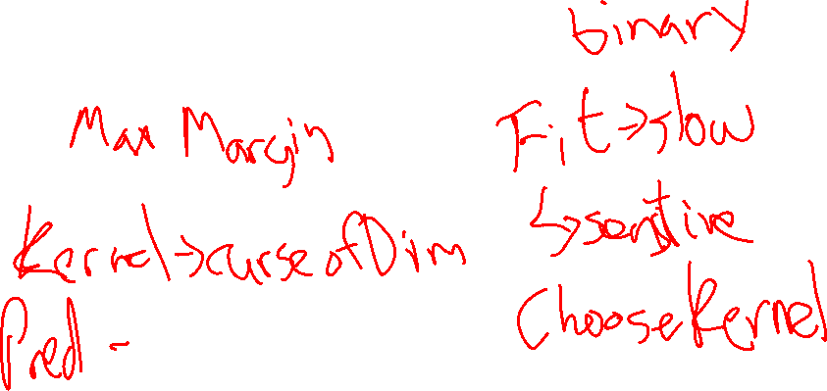
Support Vector Machines w/ Kernel
Pro
Con

Slide 158
Support Vector Machines w/ Kernel
Pro
Con (Ex)
Linear decision boundary
Linear boundary in higher-dimension space
Sparse solution (only a small percentage of samples are Support Vectors)
Binary only
Slow
Manual selection of Kernel

